Slide 1
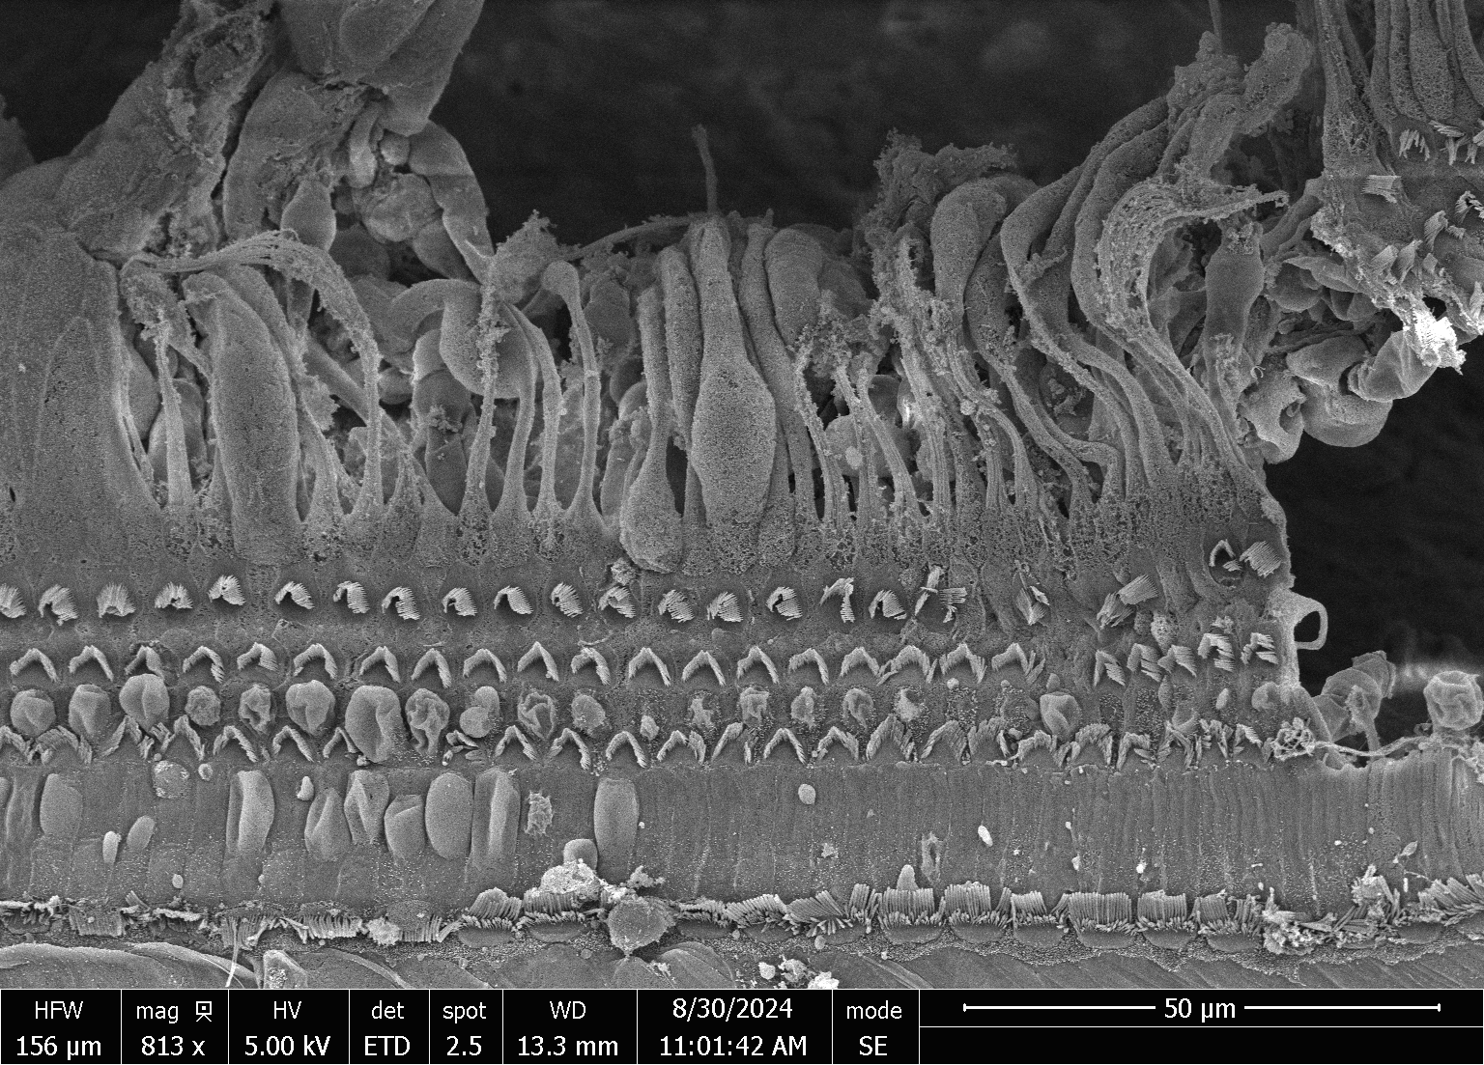
Is MESNA Safe in Middle Ear Surgeries? An Animal Study
Inabat Yermesheva MD; Ostap Orishchak MD; Tall Hady MD; Emily Kay-Rivest MD; Karina Théorêt MSc; Kevork Atamyan MS; Sam Daniel MD, MDCM
ABSTRACT
RESULTS
Objective: Mesna, a thiol-containing compound, assists in otological surgeries such as cholesteatoma and tympanosclerosis, adhesive otitis media by breaking down pathological tissues through its mucolytic properties, acting as a chemical dissector.
In this study, the aim was to evaluate the ototoxic potential of 100% topical MESNA administration(both in powder and solution) in the middle ear using an animal model.
Methods: Seventeen female albino guinea pigs were used in the experiment. The guinea pigs were randomly distributed, and all of them underwent myringoplasty. Group 1 received 100% mesna powder in one ear, while the other received powdered boric acid, a non-ototoxic control substance. Group 2 received 100% mesna solution in one ear, while the other received saline solution, as a non-ototoxic control substance. In a separate instance, a single guinea pig underwent artificial fistula creation on the medial wall of the middle ear, followed by 100% mesna solution application.
Ototoxicity was assessed through auditory brainstem response (ABR) testing at baseline and 4 weeks post-application and scanning electron microscopy (SEM) of cochlear hair cells approximately 2 months post-application.
Results: No inflammation was observed in any ear canal. ABR measurements remained consistent between baseline and 4 weeks post-application. SEM analysis in all groups revealed no damage to inner or outer hair cells.
Discussion: However, further studies with larger sample sizes and long-term follow-up are necessary to confirm these results and fully evaluate potential risks.
ABR measurements demonstrated no significant changes in hearing thresholds between baseline (immediately post-myringotomy) and four weeks post-application in any of the experimental groups.
All recorded thresholds remained within normal hearing ranges for guinea pigs (≤ 25 dB).
INTRODUCTION
Figure 1. Auditory brainstem response thresholds in (A) control ears and (B) experimental ears at baseline and 4 weeks post-intervention.
Mesna (sodium 2-mercaptoethane sulfonate) has demonstrated a valuable role in otologic surgery, primarily attributed to its mucolytic effect. This ability to disrupt disulfide bonds within pathological tissues has facilitated its application in the surgical management of diseases such as cholesteatoma and tympanosclerosis.
In cholesteatoma surgery, Mesna facilitates the breakdown of the pathological keratinous buildup within the cholesteatoma matrix. This softening effect simplifies surgical dissection, minimizing trauma to delicate middle ear structures, such as bthe ossicular chain, facial nerve, and labyrinth. By promoting thorough removal of the cholesteatoma, Mesna may reduce the incidence of residual disease and subsequent revision surgeries. [3,4,5].
Tympanosclerosis, characterized by abnormal calcium deposition and ossicular chain fixation, presents a significant surgical challenge. Mesna's mucolytic action can soften and loosen calcified plaques, easing their removal and aiding in the mobilization of the ossicular chain. This is particularly crucial in addressing conductive hearing loss resulting from ossicular fixation. [1,2].
Despite its efficacy, the otologic safety of Mesna has not been comprehensively evaluated. Therefore, the objective of this study was to assess the safety of 100% Mesna powder and solution when applied to an exposed middle ear, using a validated animal model.
SEM of the cochleas revealed no signs of ototoxicity.
3 rows of outer hair cells (top) and a single row of inner hair cells (bottom).
(Figure 2).
METHODS AND MATERIALS
Sample
- 17 white female albino guinea pigs with normal baseline hearing levels.
Group 1 received 100% mesna powder in one ear, while the other received powdered boric acid, a non-ototoxic control substance. Group 2 received 100% mesna solution in one ear, while the other received saline solution, as a non-ototoxic control substance. In a separate instance, a single guinea pig underwent artificial fistula creation on the medial wall of the middle ear, followed by 100% mesna solution application.
Figure 2. Normal organ of Corti obtained from a mesna-treated animal.
DISCUSSION
CONCLUSION
-The safety profile of 100% mesna (powder/solution) applied topically to the middle ear in a guinea pig model was demonstrated.
-Good ABR and SEM analyses is highly significant, given mesna's established mucolytic efficacy in complex otological surgeries like cholesteatoma and tympanosclerosis, where it facilitates precise tissue dissection and minimizes trauma to delicate structures [1, 2, 3, 4, 5].
The absence of ototoxicity observed here directly addresses a critical safety concern, potentially paving the way for wider clinical adoption of mesna. This could translate to improved surgical precision, reduced complication rates, and enhanced patient outcomes. Furthermore, the fistula observation suggests potential safety even in compromised middle ear environments.
Topical application of 100% mesna, in both powder and solution forms, to the middle ear of guinea pigs did not demonstrate ototoxicity as assessed by auditory brainstem response (ABR) and scanning electron microscopy (SEM). Furthermore, in a single instance where mesna solution was applied after creating an artificial fistula on the medial wall of the middle ear, no signs of ototoxicity were observed. These findings may have significant implications for the surgical management of middle ear surgeries, potentially increasing its adoption by otology surgeons.
However, further studies with larger sample sizes and long-term follow-up are warranted to confirm these results and fully evaluate potential risks.
1. Auditory brainstem responses (ABRs)
ABRs were collected at 4 different timepoints:
Pure tone bursts presented: 24, 20, 16, 12, 8 kHz
Intensities: 70 to 20 dB, decreasing in 5-10 dB steps
Presented to one ear at a time to reduce noise interference.
4w post-treatment
Post-myringotomy
2. Scanning electron microscopy (SEM)
Following ABR recordings, scanning electron microscopy (SEM) was performed on 9 randomly selected guinea pig's cochlea to assess the medication's potential ototoxicity.
Presenting author
References
Research supported by:
Inabat Yermesheva, MD
McGill Otolaryngology Sciences Laboratory
McGill University, Montreal, QC, Canada
inabat.yermesheva@mail.mcgill.ca
(514) 290 56 96
1. Eren SB, Dogan R, Vural Ö, et al. Use of Mesna in the treatment of ossicular chain fixation related to tympanosclerosis; prospective, clinical study. Am J Otolaryngol. 2020;41(4):102506. doi: 10.1016/j.amjoto.2020.102506
2. Yilmaz M, Goksu N, Bayramoglu I, Bayazit YA. Practical use of MESNA in atelectatic ears and adhesive otitis media. ORL J Otorhinolaryngol Relat Spec. 2006;68(4):195-198. doi:10.1159/000091472
3. Kalcioglu MT, Cicek MT, Bayindir T, Ozdamar OI. Effectiveness of MESNA on the success of cholesteatoma surgery. Am J Otolaryngol. 2014;35(3):357-361. doi:10.1016/j.amjoto.2014.01.002
4. Çelik S, Yalçın MZ, Kılıç O, Tan M, Kalcioğlu MT. Long-Term Results of Sodium 2-Mercaptoethane Sulfonate Usage on Cholesteatoma Surgery. J Int Adv Otol. 2024;20(3):231-235. doi:10.5152/iao.2024.231208
5. de la Torre C, Villamor P. Chemically Assisted Dissection With Sodium 2-Mercaptoethanesulfonate (MESNA) in the Surgical Management of Pediatric Cholesteatoma. Otol Neurotol. 2019;40(5):645-650. doi:10.1097/MAO.0000000000002174

