Slide 1

Comparison of electrocautery versus coblation technique in pediatric patients requiring tonsillectomy
Hady Tall, Ostap Orishchak ,Sam J Daniel

Slide 2
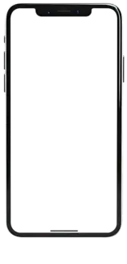

Methods
Survey (paper or electronic)
Pre-surgical questionnaire
Pain evaluation (survey based on the Parents’ Postoperative Pain Measure (PPPM)¹
Medication administered at home (non-opiods and opioids)
Post-surgical questionnaire
Chambers CT, Reid GJ, McGrath PJ, Finley GA. Development and preliminary validation of a postoperative pain measure for parents. Pain 1996;68:307–13.

Slide 3
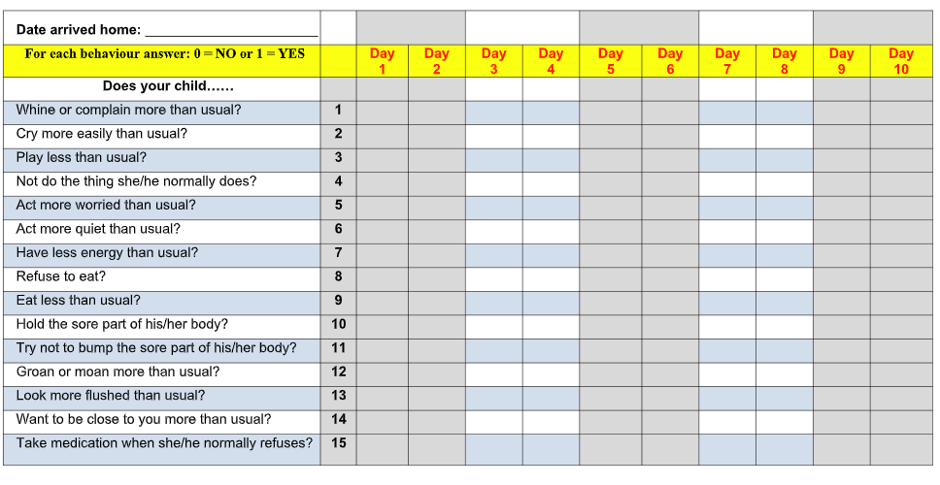
Methods
e
1. Chambers CT, Reid GJ, McGrath PJ, Finley GA. Development and preliminary validation of a postoperative pain measure for parents . Pain 1996;68:307–13.

Slide 4
Methods
187 participants sign the consent form
21 participants were not included in the data analysis:
1 tonsillectomy was not performed;
4 data extraction failures;
16 did not complete any questionnaires.
166 participants included in data analysis
68 had total tonsillectomy
98 had partial tonsillectomy
68 electrocautery
63 microdebrider
35 coblation

Slide 5
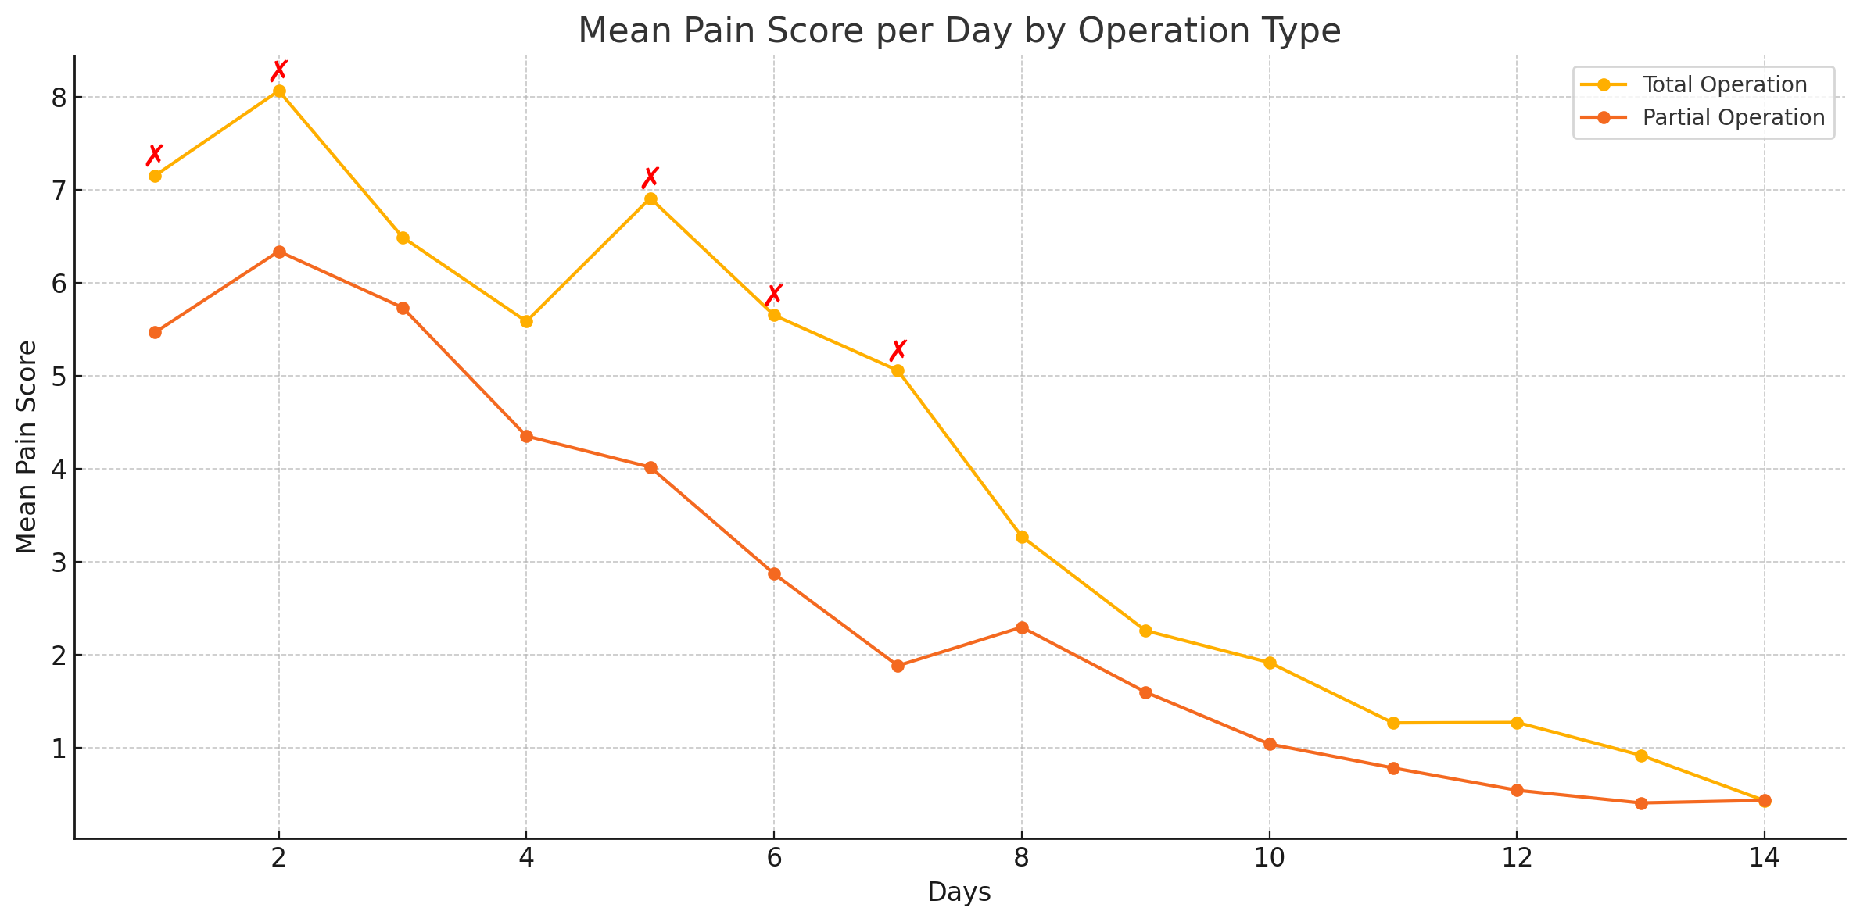
Results

Slide 6
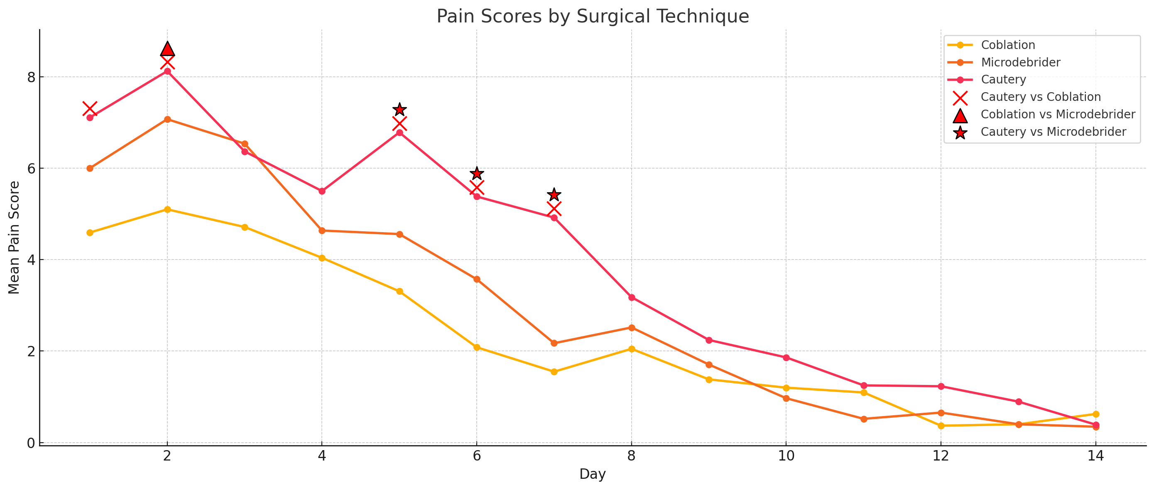
Results

Slide 7
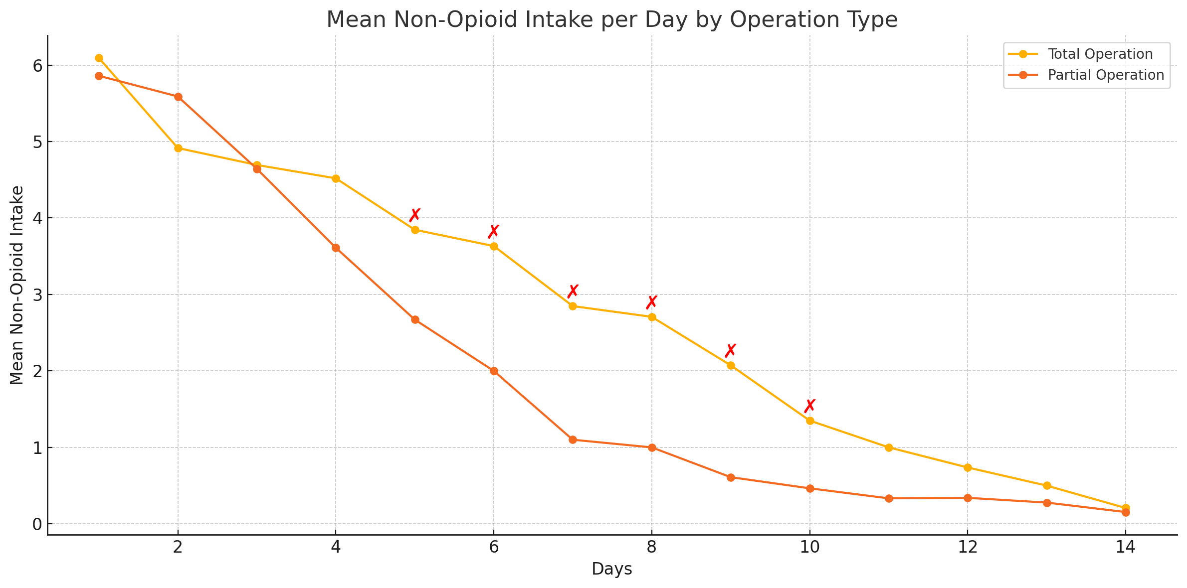
Results

Slide 8
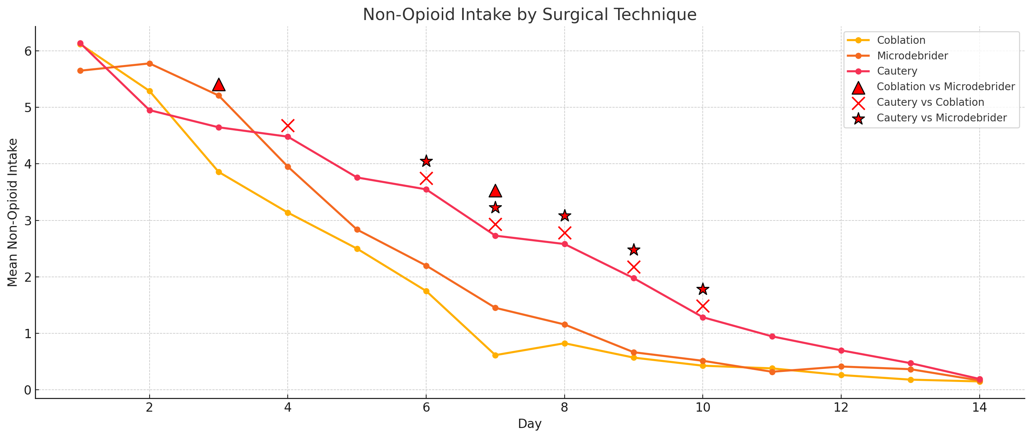
Results
Notes:
Patients who had coblation experienced significantly less self-reported pain complaints during the first 7 days compared to the cautery group (p<0,05). After 7 days, the pain scores between the two groups were similar (p>0,05).
Coblation vs microdebrider: There is a trend indicating that patients in the coblation group experienced less pain during the first 7 days post-operation. However, this did not reach statistical significance (p > 0.05)

Slide 9
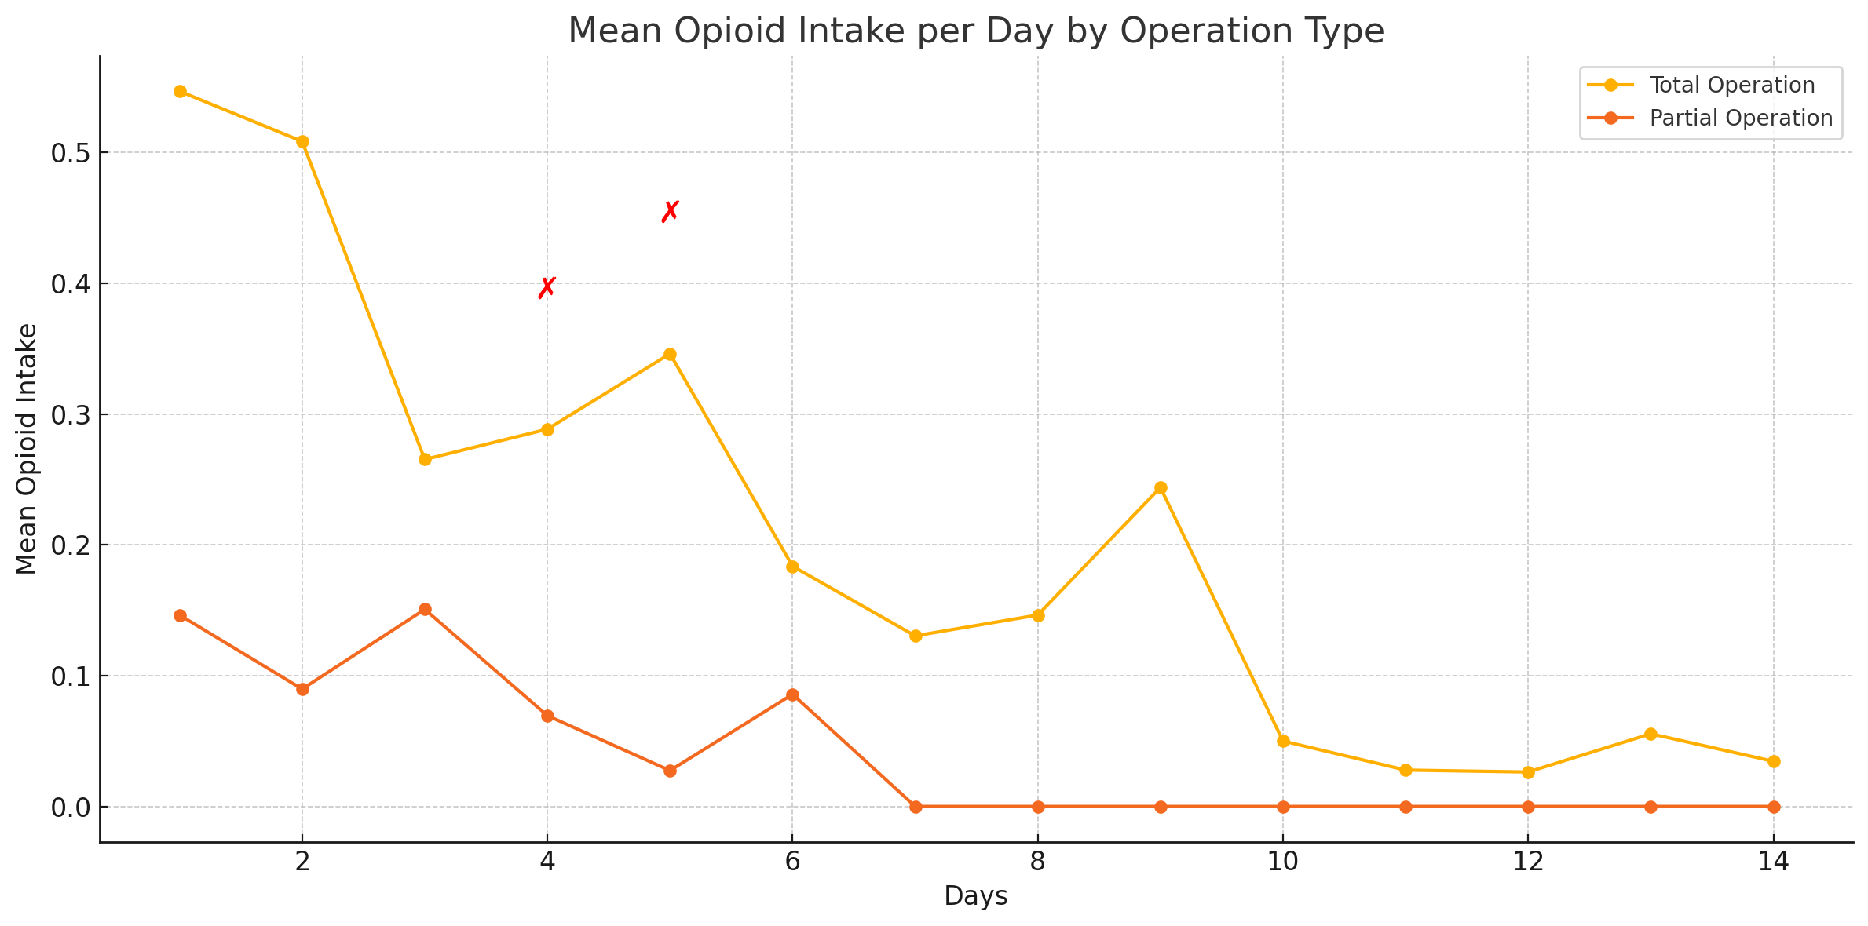
Results

Slide 10
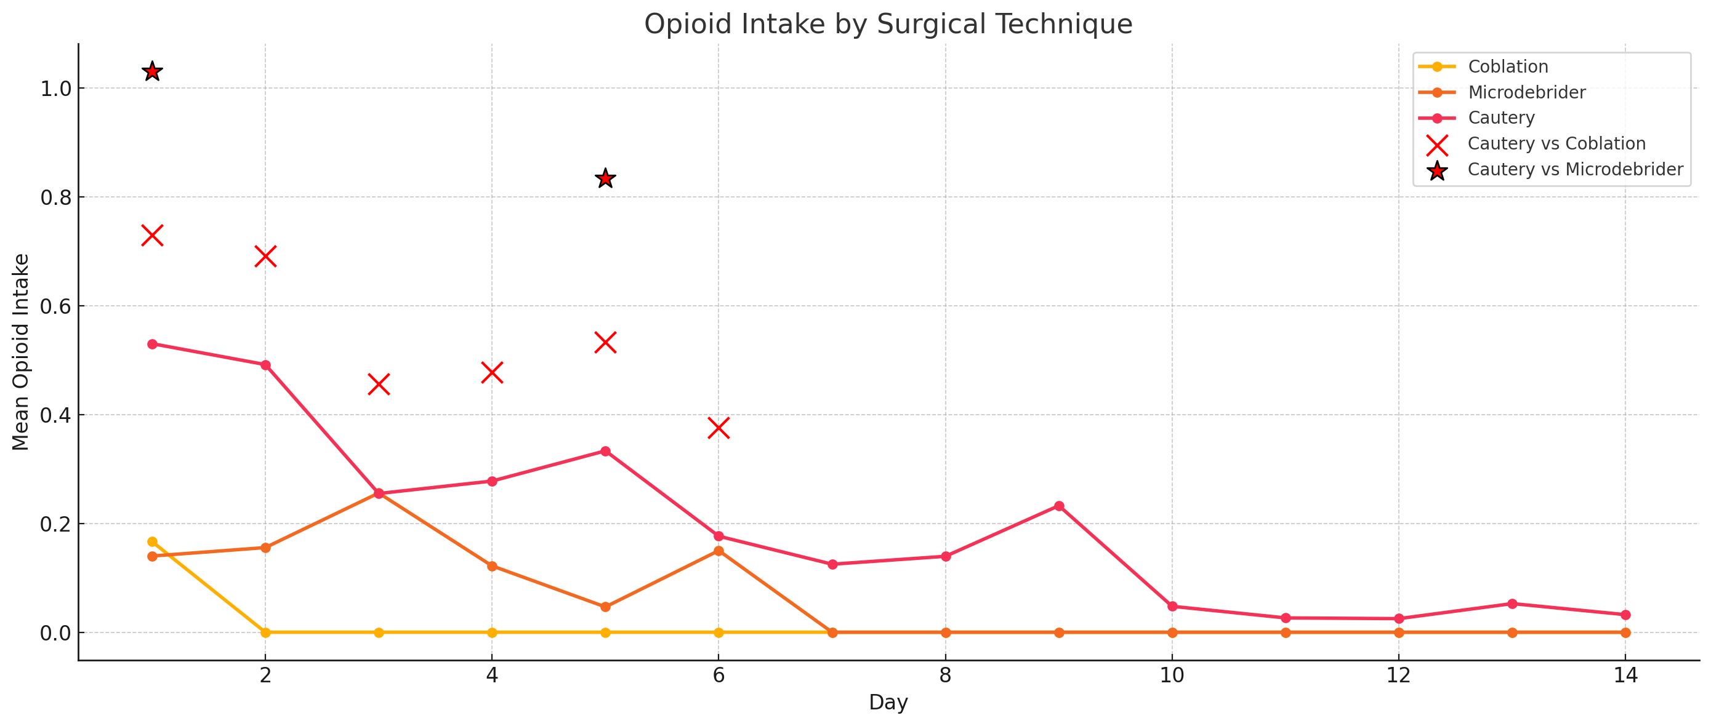
Results

Slide 11
Discussion

Slide 12

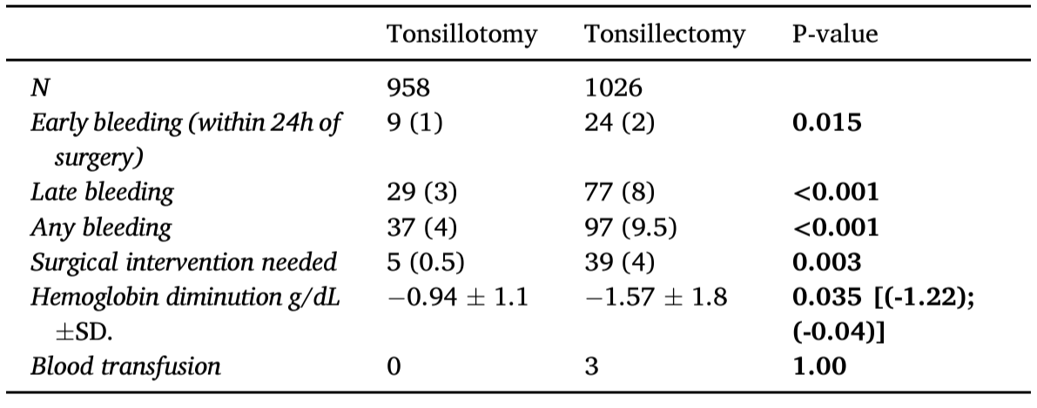
Discussion
Conclusion: Among children undergoing tonsillar surgery for obstructive sleep apnea, tonsillotomy was associated with a safer postoperative bleeding profile, reduced bleeding severity, and fewer readmissions compared to tonsillectomy.

Slide 13
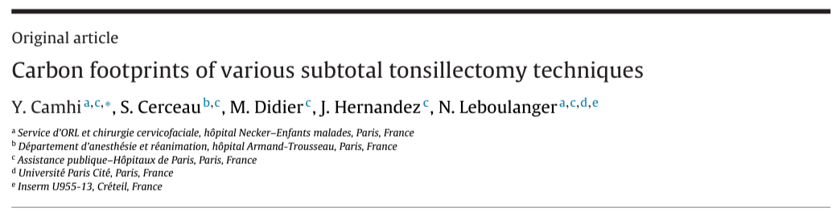

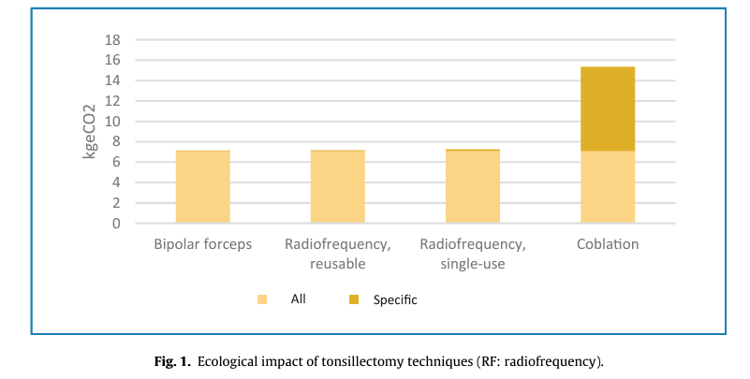
The carbon footprint of subtotal tonsillectomy using bipolar forceps only was 7.101 kg eCO2. Extra emissions with use of a reusable radiofrequency needle were 0.06 kg eCO2, and 0.143 kg eCO2 with a single-use needle.
Coblation generated a carbon footprint of 8.6 kg eCO2, versus 0.1–0.2 kg eCO2 for the other techniques.
Notes:
Published: 2024
Results: Coblation generated a carbon footprint of 8.6 kg eCO2, versus 0.1–0.2 kg eCO2 for the other techniques.

Slide 14

 | Cautery | Microdebrider | Coblator
Postoperative pain | ++++++ | ++++ | +++
Risk of bleeding | +++ | + | +
Operative time | + | + | ++
Cost | + | ++ | +++++
Carbon footprint | + | + | +++
Health risk for OR personnel | + | + | ++
288.77-312.83 $
2.64+
21.83 $
125.4+
37.82 $
Notes:
288.77-312.83 $

Slide 15
SENEGAL
Senegal : 196 000 km
18 millions habitants
75 ENT , 8 residents
40 ENT departements (2 pediatrics departements)
Saint Louis : 4 ENT 1 resident
Adéno-amygdalectomie chez l’enfant (Indications et résultats) :
A propos de 403 cas colligés au service d’ORL du Centre Hospitalier Régional de Saint-Louis

Slide 16

Thank Merci

